Slide 1
BST and more on Trees
CPSC 131 - Data Structure
Shrinivas P. Patil

Slide 2
BST node Deletion
There are 3 scenarios:
Deletion of a leaf node
Deletion of a node with single child
Deletion of a node with both children

Slide 3
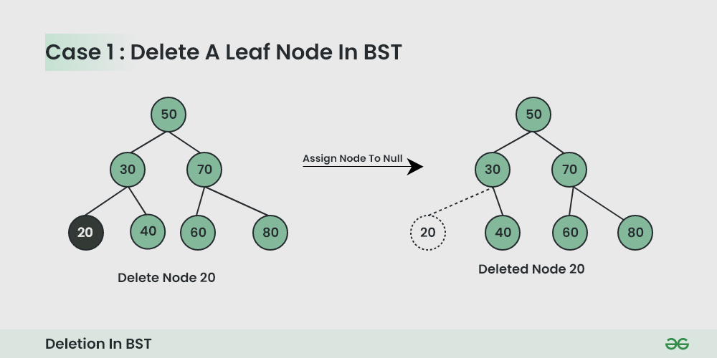
Deletion of leaf node
Deleting single child node is very simple
Delete the node and set pointer of parent to null.

Slide 4
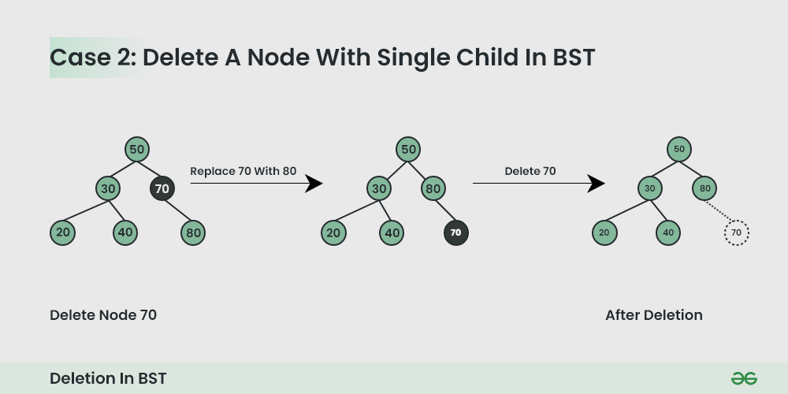
Deletion of a node with single child
Deletion of node with single child is also simple
Swap the contents of parent and child
Then delete child node and set pointer

Slide 5
Deletion of node with both the children
Deletion is not that simple
Delete the node in such a way that rest of the tree will follow properties of BST
Find inorder successor or predecessor
Copy the contents of inorder successor and delete the inorder successor

Slide 6
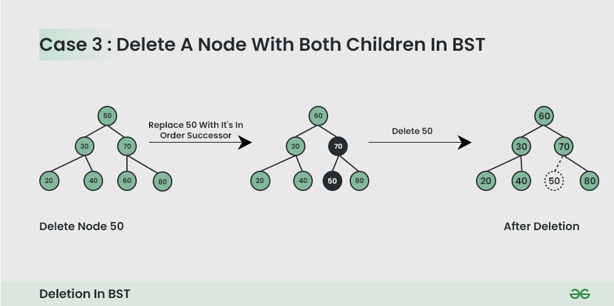

Slide 7
Pseudocode
Deletion(root,val){
If root==null{return False;}
// Deletion of leaf node
If(val<root.val){
root.left = Deletion(root.left,val);
Return root;
}
Else if(val>root.val){
Root.right = Deletion(root.right,val)
Return root;
}
//Deletion of node with one child
if(root->left==null){
temp = root->left;
Delete root;
return temp;
}
Else if(root->right==null){
temp = root->right;
Delete root;
return temp;
}

Slide 8
Pseudocode
//deletion of a node with both children
succ = findminimum(root->right);
Int value = succ->val;
Deletion(succ,root->val);
root->val = value;
}

Slide 9
Problem
Given insertion order of nodes [50,23,45,67,12,78,59,29,55,62,72,89] perform following deletion operations:
Delete(12)
Delete(45)
Delete(67)

Slide 10
BST operation efficiency
Operation | Efficiency
Insert | O(n)=O(h)
Search | O(n)=O(h)
Delete | O(n)=O(h)

Slide 11
Recall: BST Height is O(n)
h = height of tree
Worst-case BST has height h = n-1 is O(n)
Plain BST: O(h) = O(n)
Soon: self-balancing BST has height O(log n)
4
4
4
3
3
3
2
2
2
1
1
1
0
0
0

Slide 12
Constructor (create empty)
Initialize root to null
Initialize size to 0
O(1) time

Slide 13
Search(key)
Only difference between Contains(key) and Find(key) is the return type and exception policy
Contains(key) returns bool and never throws
Find(key) returns a reference to a pair, or throws
Find(key) performs BST search
Find(key) is O(h) = O(n)

Slide 14
InsertNode(val)
Loop goes from root to leaf
O(1) time per level
O(h) time total
Creating the new child is O(1)
Updating parent’s pointer is O(1)
InsertNode(pair) is O(h)+O(1)+O(1) = O(h) time

Slide 15
Insert
Contains node is O(h)
InsertNode(val) is O(h)
size++ is O(1)
return true is O(1)
Insert(val) is O(h)+O(h)+O(1)+O(1) = O(h) time
Insert(val): if Contains(val) return false InsertNode(val) size++ return true

Slide 16
RemoveZeroOrOneChild(u)
If(val<root.val){
root.left = Deletion(root.left,val);
Return root;
}
Else if(val>root.val){
Root.right = Deletion(root.right,val)
Return root;
}
O(logn)
f(root->left==null){
temp = root->left;
Delete root;
return temp;
}
Else if(root->right==null){
temp = root->right;
Delete root;
return temp;
}
O(1)

Slide 17
RemoveNode(u)
succ = findminimum(root->right);
Int value = succ->val;
Deletion(succ,root->val);
root->val = value;
}
Worst case: else (2 children)
RemoveZeroOrOneChild(u) is O(1) time
while loop is O(h) time to find minimum.
Other statements are O(1) time
RemoveNode(u) is O(1)+O(h)+O(1) = O(h) time

Slide 18
BST operation efficiency
Time efficiency
Operation | Efficiency
Insert | O(n)=O(h)
Search | O(n)=O(h)
Delete | O(n)=O(h)

Slide 19
Applications of BST
Searching and sorting
Symbol tables
Compression algorithms: Huffman coding
Database indexing
Game Trees:BSTs are used to represent game trees for games like chess, tic-tac-toe, and more.
Memory management

Slide 20
Solve problems in BST
Find sum of all nodes in a tree
Find Min/max element in a BST
Find odd/even elements in a BST

